Slide 1

Cyclistic Bike-Share
How do annual members and casual riders use Cyclistic bikes differently?
Author: Ahmed Nasser
Created: 3/3/2024

Slide 2
Introduction:
Cyclistic is a bike-share program in Chicago that features more than 5,800 bicycles and 600 docking stations. Cyclistic sets itself apart by also offering reclining bikes, hand tricycles, and cargo bikes, making bike-share more inclusive to people with disabilities and riders who can’t use a standard two-wheeled bike. Most riders opt for traditional bikes; about 8% of riders use the assistive options. Cyclistic users are more likely to ride for leisure, but about 30% use the bikes to commute to work each day.

Slide 3
Objectives:
The main objective is to convert the Casual riders to Members, but first we need to know the differences between them, by answering the below questions:
What is the weekly average ride length for casual and members riders?
Is there a correlation between the seasons in Chicago and the number of rides?
Is there a correlation between the seasons in Chicago and ride length?
What is the average number of rides on each day of the week?
What is the average ride length on each day of the week?
Which stations do casual riders often visit?
What is the most used bike type for casual riders?

Slide 4
Overview:
In this project we will analyze the Cyclistic’s data to get insights and answer questions using the six steps of the data analysis process (Ask, Prepare, Process, Analyze, Share, and Act) using R for processing and cleaning, SQL for summarizing and analyzing, Tableau for visualizing the data, and PowerPoint for presenting the insights to answer the business task which is “How do annual members and casual riders use Cyclistic bikes differently?”

Slide 5
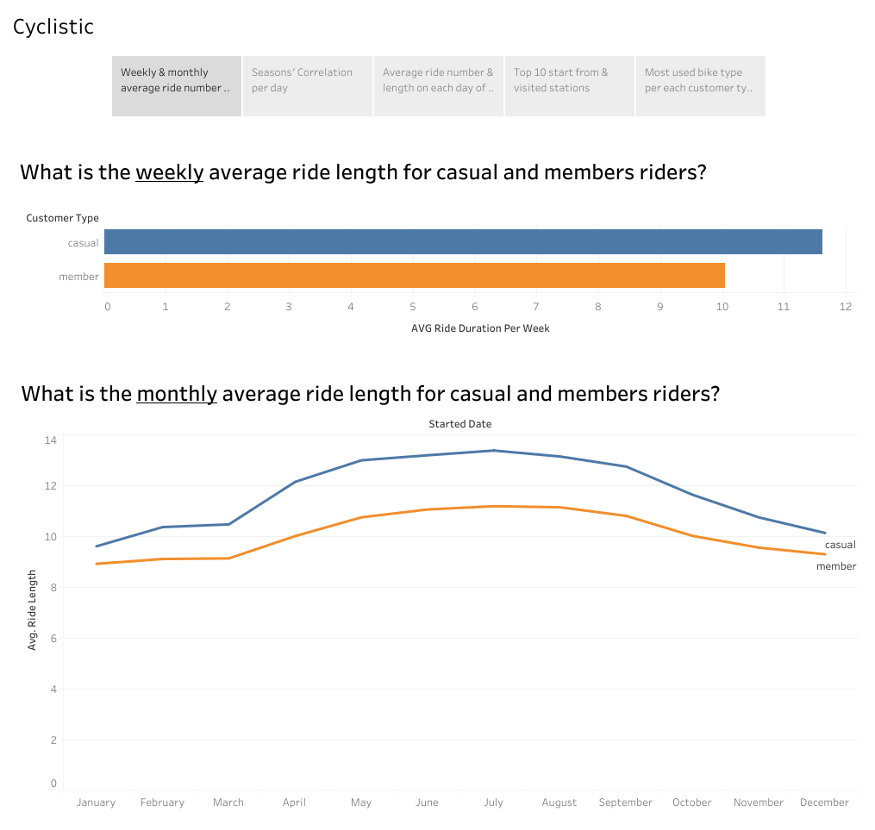
From this viz we notice that Casual riders have a higher average weekly ride length (11.625) than member riders.
And Casual riders have a higher average monthly ride length than member riders over the year.

Slide 6
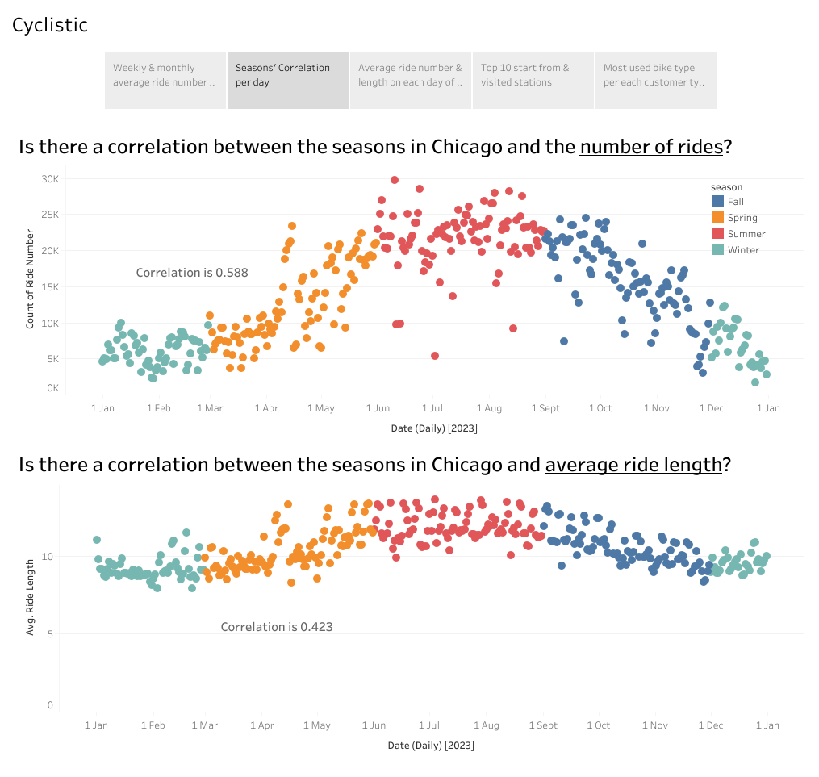
The correlation between the seasons and the number of rides is (0.588), meaning there is a strong correlation between them, with a noticeable increase in the summer.
There are a moderate correlation between the seasons and the average daily ride length (0.423), meaning there is a correlation, but not strong.

Slide 7
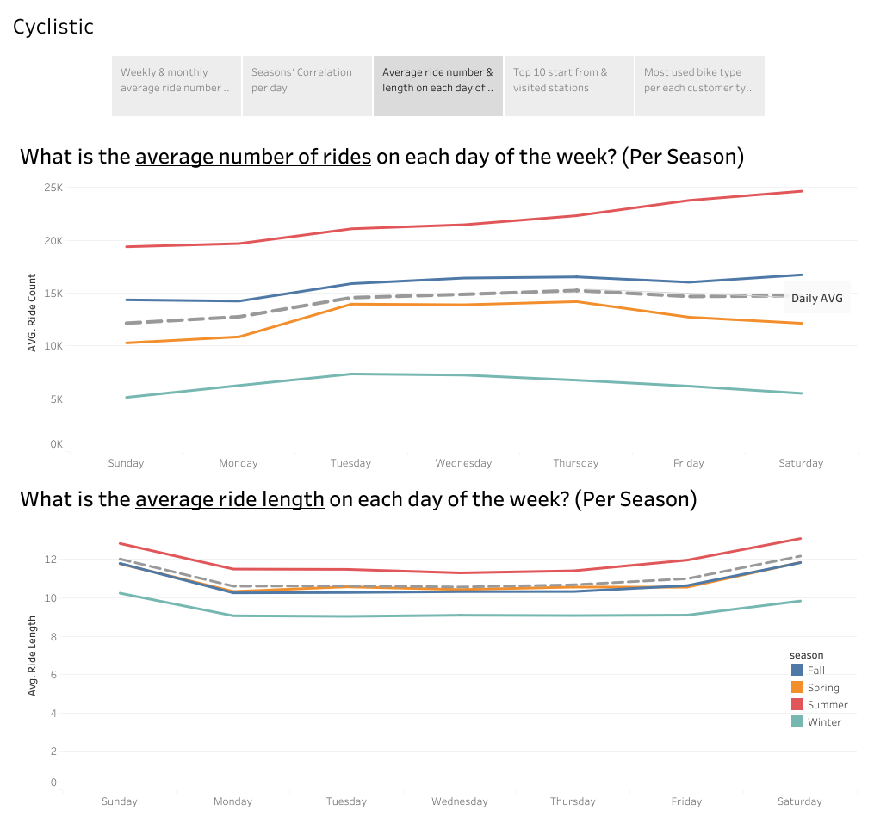
The number of rides increases on Wednesday, and Thursday with the peak on Thursday.
The ride length increases on Saturday and Sunday with the peak on Saturday.

Slide 8
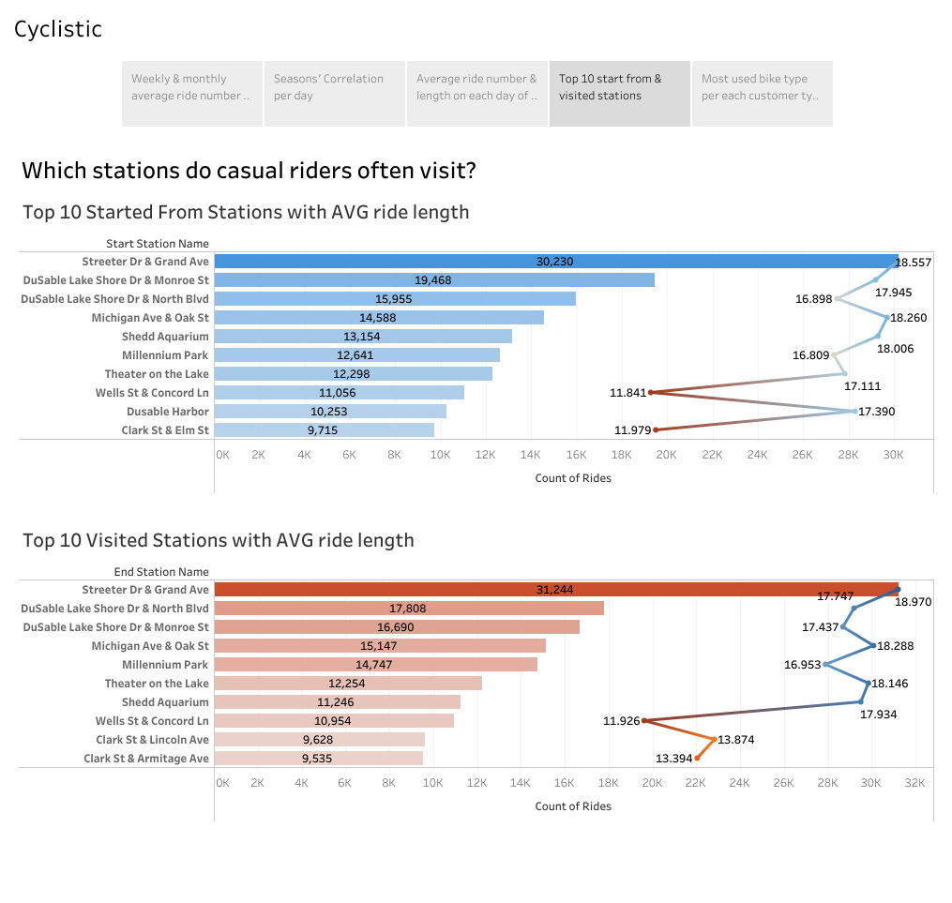
AVG ride length
The top visited stations are:
Streeter Dr & Grand Ave.
DuSable Lake Shore Dr & North Blvd.
DuSable Lake Shore Dr & Monroe St.
With a noticeable high average ride length in those areas.

Slide 9
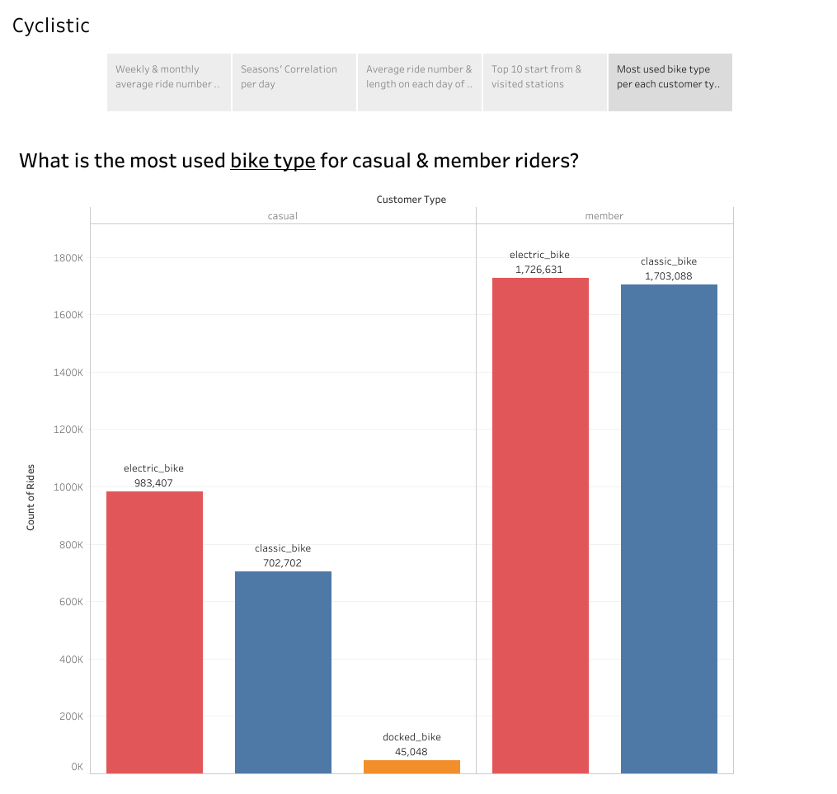
The most used bike type is the electric bike, followed by the classic bike for both Casual and Member customers.

Slide 10
Conclusion:
We found that casual riders tend to ride longer distances on average than member riders. Thus, introducing different packages would likely attract casual riders to subscribe.
There is a strong correlation between the number of rides and the seasons, with a noticeable increase starting from the end of the spring till the beginning of the fall, meaning that riders prefer hot weather.
Ride numbers increase on weekdays, but ride durations increase on weekends, indicating that casual riders spend more time riding on weekends when they have free time to spare.
Upon conducting an online search for the most visited stations, it was found that they are all located in or near parks, meaning they take the rides to visit the parks.
Electric bikes are the most used by both types of riders. They are equipped with a thumb throttle and pedal assist, which makes it easier to travel further and tackle steep hills.

Slide 11
Recommendations:
Launch a weekly and monthly package for riders who have a high average ride duration.
Seasonal offer with a discount for new members that starts from the end of spring until summer.
Create a special discount at weekends for members whose ride length is longer than 25 minutes.
Design merchandise such as shirts and water bottles with the company logo in the top visited parks.
Discount on parks tickets for members who arrive with Cyclistic bikes.
Increase the number of electric bikes in the steep hills' areas.

Slide 12
Appendix:
Here’s a link for the R Markdown documentation file to go through all the process step by step:
https://a7mdnasrr.github.io/AhmedNasser.github.io/rmarkdown/index.html
Link to the tableau dashboard: https://public.tableau.com/app/profile/ahmed.nasser.viz/viz/BikeShare_17087406050140/CyclisticStory

Slide 13
Thank You

